Slide 1
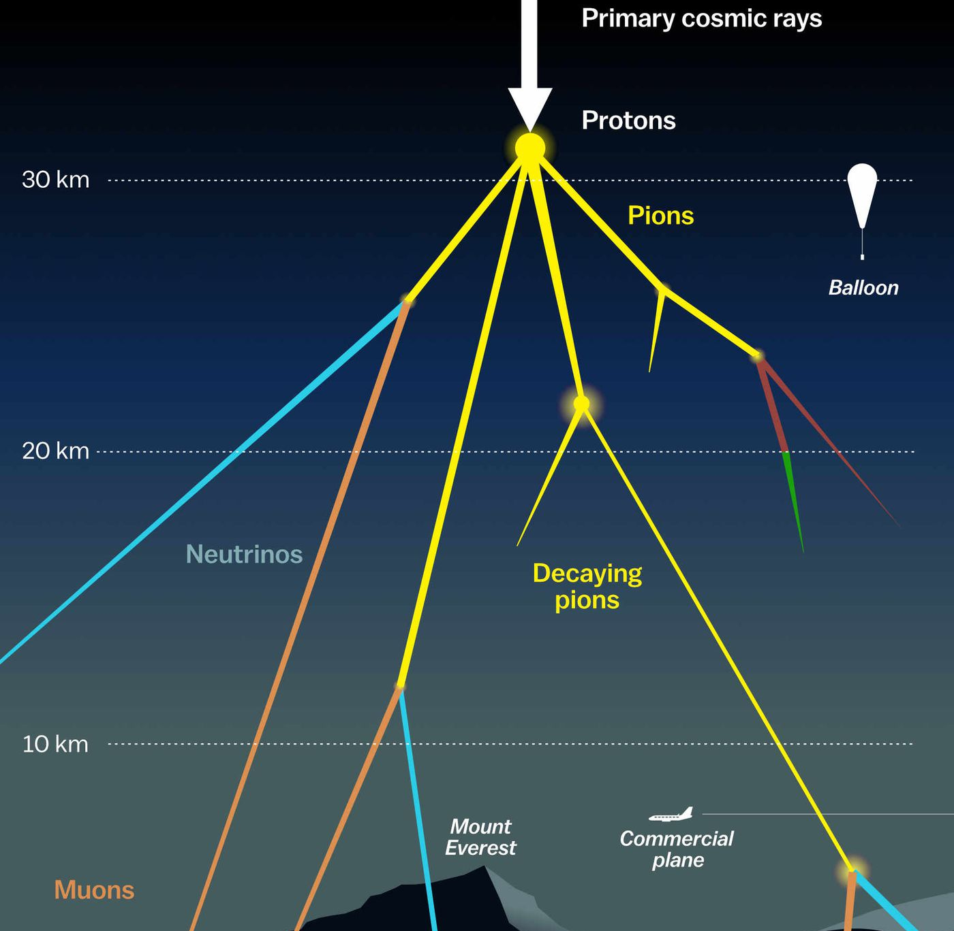
Ideas to measure the prompt component of the atmospheric muon flux Jean-Marco Alameddine, Ludwig Neste and Pascal Gutjahr
Cosmic Rays in the Multi-Messenger Era
Paris 2022
https://www.vox.com/the-highlight/2019/7/16/17690740/cosmic-rays-universe-theory-science

Slide 2


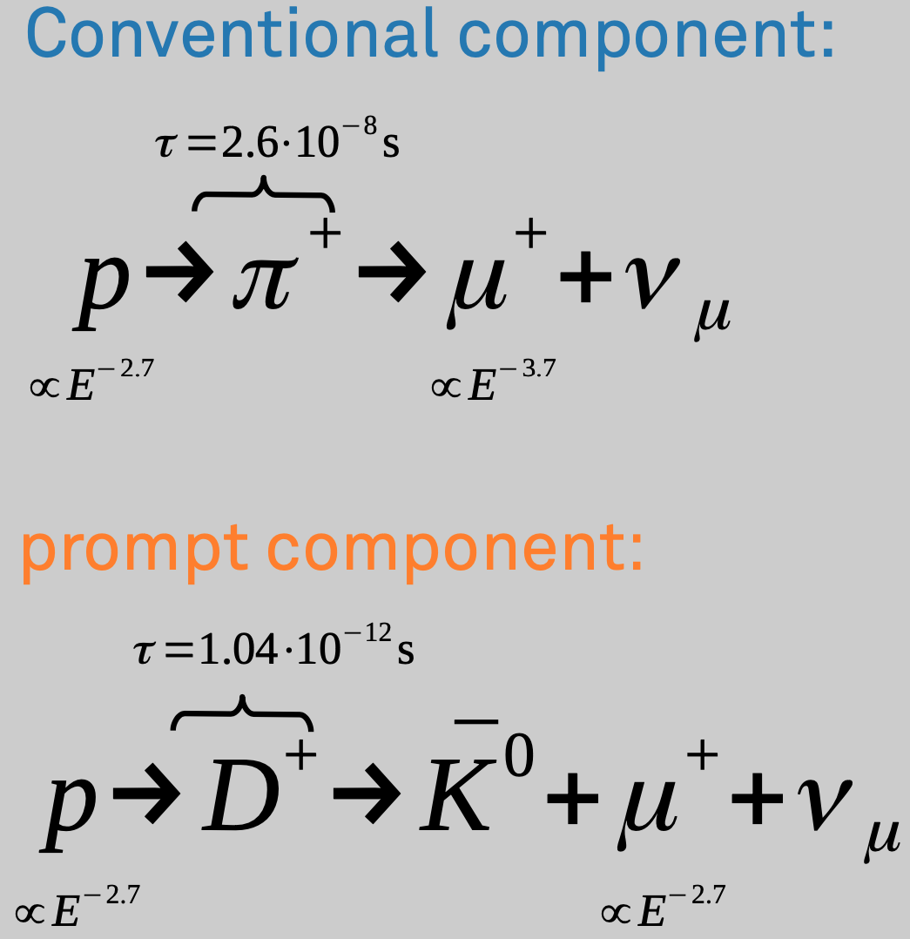

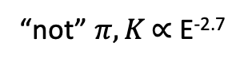
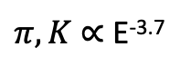
Definition of the muon flux
$φ_{tot}=φ_{conv}+φ_{prompt}$
$π, Κ$ ∝ E^{-3.7}
“not” $π, Κ \text{∝ }\text{E}\text{-}\text{2}\text{.7}$
(all particles with a decay length lower than 0.123 cm)

Slide 3
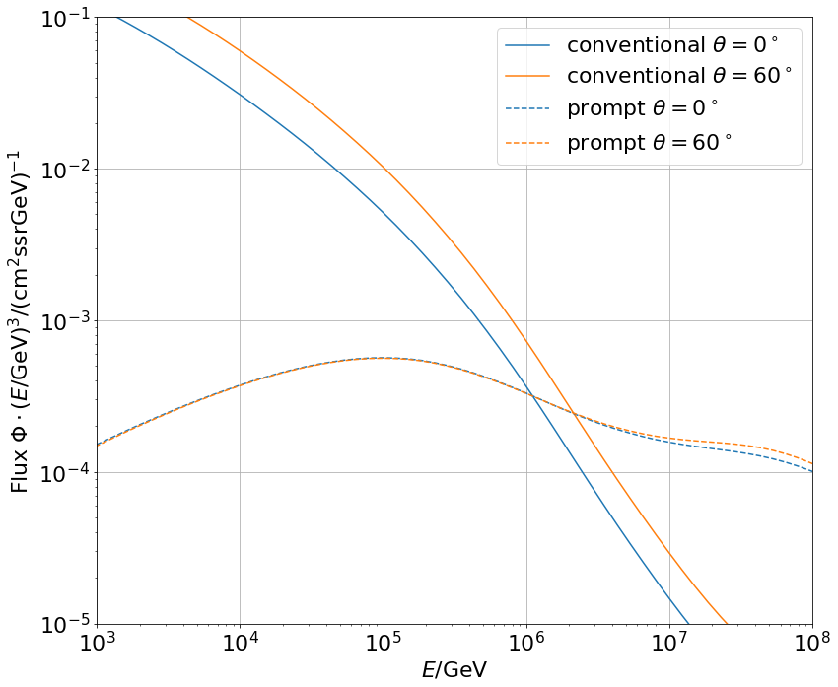
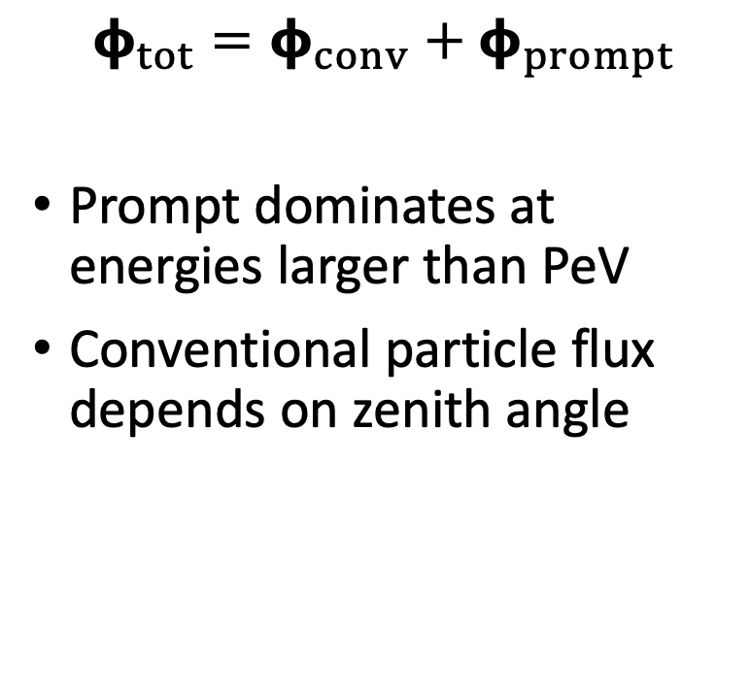
Muon flux
0°: perpendicular to Earth’s surface
$$φ_{tot}=φ_{conv}+φ_{prompt}$$
Prompt dominates at energies larger than PeV
Conventional particle flux depends on zenith angle
conventional
prompt

Slide 4
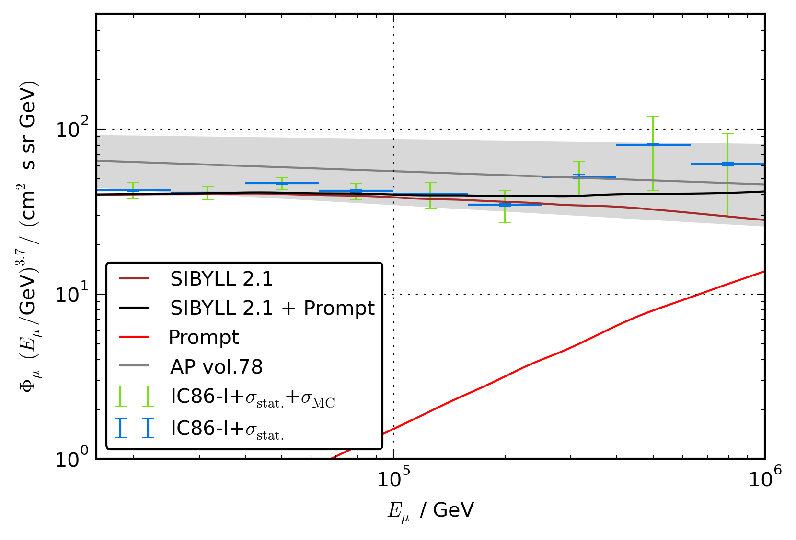
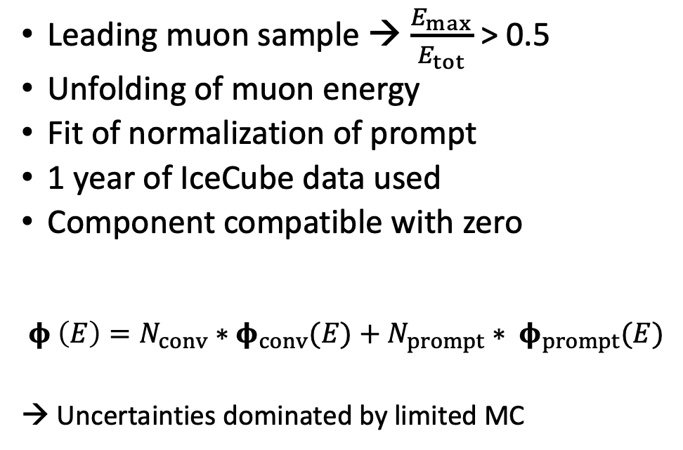
Previous analysis
Leading muon sample → $\frac{E_{max}}{E_{tot}}$ > 0.5
Unfolding of muon energy
Fit of normalization of prompt
1 year of IceCube data used
Component compatible with zero
$$φ \left(E\right)=N_{conv}∗φ_{conv}(E)+N_{prompt}∗ φ_{prompt}(E)$$
→ Uncertainties dominated by limited MC
[T. Fuchs, PhD Thesis, 10.17877/DE290R-17241]

Slide 5
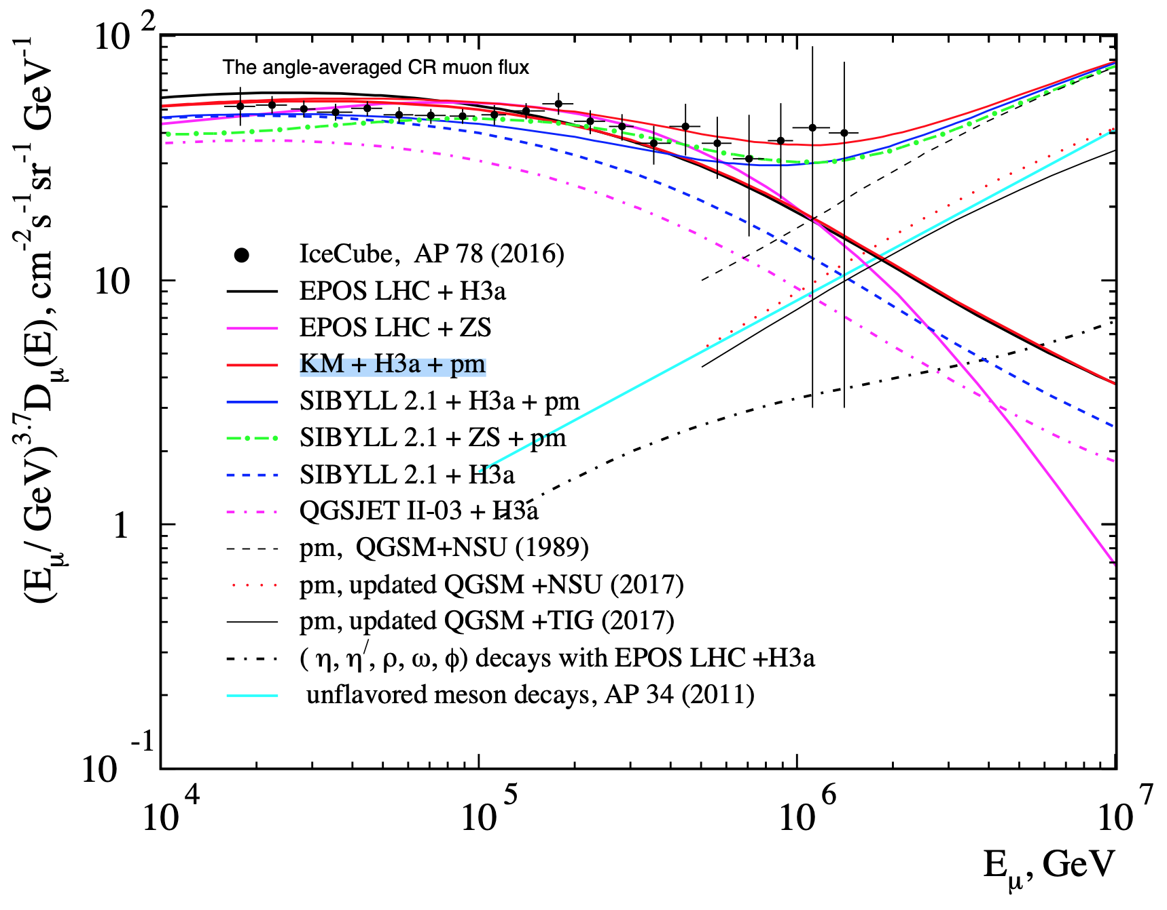
New ideas to measure the prompt component
Latest software CORSIKA, PROPOSAL
SIBYLL 2.3d → charm included
Scale amount of prompt particles to create several datasets
Tag muon parent particles in MC (prompt/conv)
If shower contains a prompt particle it is defined as prompt
Create splines/estimator of particles per bin in dependency of the scaling factor
Fit effective scaling – forward fit
Analyze:
Muon energy
Zenith angle
Time (seasonal variations)
Conventional flux depends on the season
[Journal of Physics: Conf. Series. 2019. V. 1181, 012054]

Slide 6
Identify prompt particles in air shower
CORSIKA 7
10 Mio. air showers (primary: proton)
Initial energy: 10⁵ – 10⁹ GeV
Two different injection angles 𝜃
SIBYLL 2.3d
Sampled from E⁻¹ , reweighted to Gaisser H3a
Extended history option to identify and tag the prompt particles manually
Deviations at energies > 10⁷ GeV
Maximum injected energy lower than the maximum possible energy (GZK cutoff at ~5 * 10¹⁰ GeV)
MCEq: SIBYLL 2.3c

Slide 7
Specific parent particle identification
CORSIKA 7 using SIBYLL 2.3d vs. SIBYLL 2.3c¹
Good agreement with unflavored particles
Mismatches occur for all the D-mesons
Issue not yet solved
Only protons simulated with CORSIKA
¹ Phys. Rev. D 100 (2019) 103018

Slide 8
Scaling of the prompt component - tagging
Amount of prompt particles is re-weighted with 0.5
Use tagging of prompt in CORSIKA MC
Conventional component is not much affected
If a shower contains prompt, almost no conv. particles in the shower arrive at the surface

Slide 9
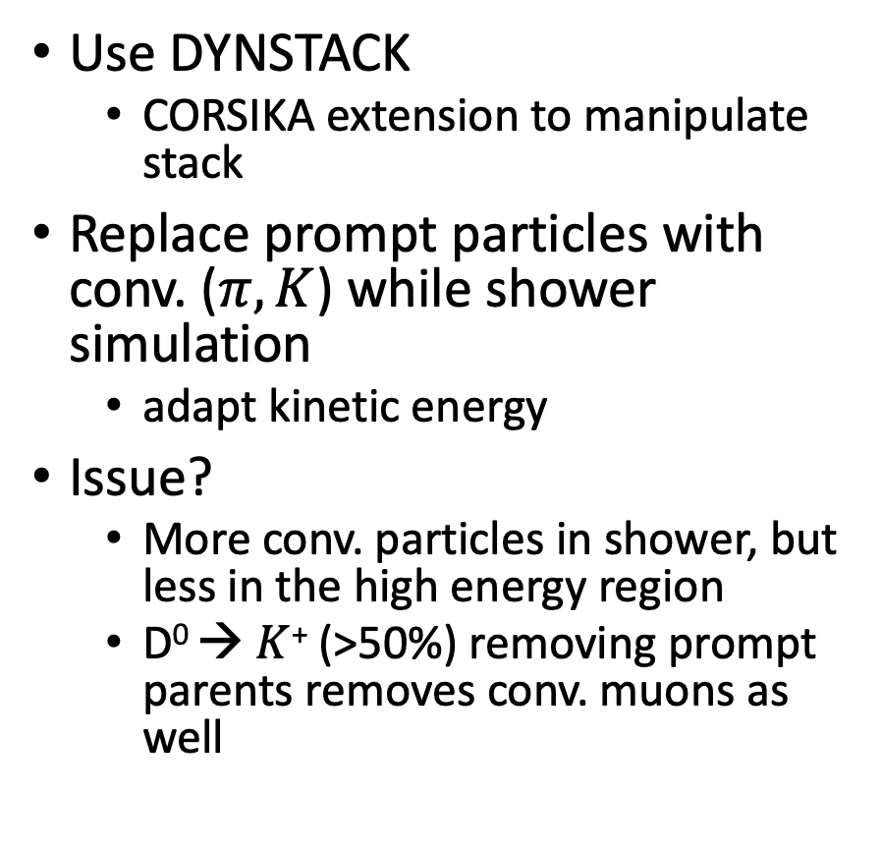
Scaling of the prompt component - DYNSTACK
Use DYNSTACK
CORSIKA extension to manipulate stack
Replace prompt particles with conv. ($π,Κ$) while shower simulation
adapt kinetic energy
Issue?
More conv. particles in shower, but less in the high energy region
D⁰ → $Κ$⁺ (>50%) removing prompt parents removes conv. muons as well

Slide 10
Summary
Previous analysis compatible with zero prompt
No charm particles were simulated
Discussion:
How to scale prompt > 1?
How to extract physical parameters?
CRC1491 → branching ratios (BR), cross-sections, particle physics
Scale BR and hadronic models compatible with LHC results

Slide 11
Next steps
Further cross-checks of prompt tagging (D-Mesons?)
Comparisons between DYNSTACK and CORSIKA scaling
Simulate new CORSIKA datasets with SIBYLL 2.3d
Charm included
Tagging of prompt particles
Scale prompt
Unfolding of the muon flux in energy and zenith bins (+seasonal variations)
Fit of the normalization/ effective scaling factor of prompt – forward fit
Analysis could be done with a neutrino telescopes such as the IceCube Neutrino Observatory

Slide 12
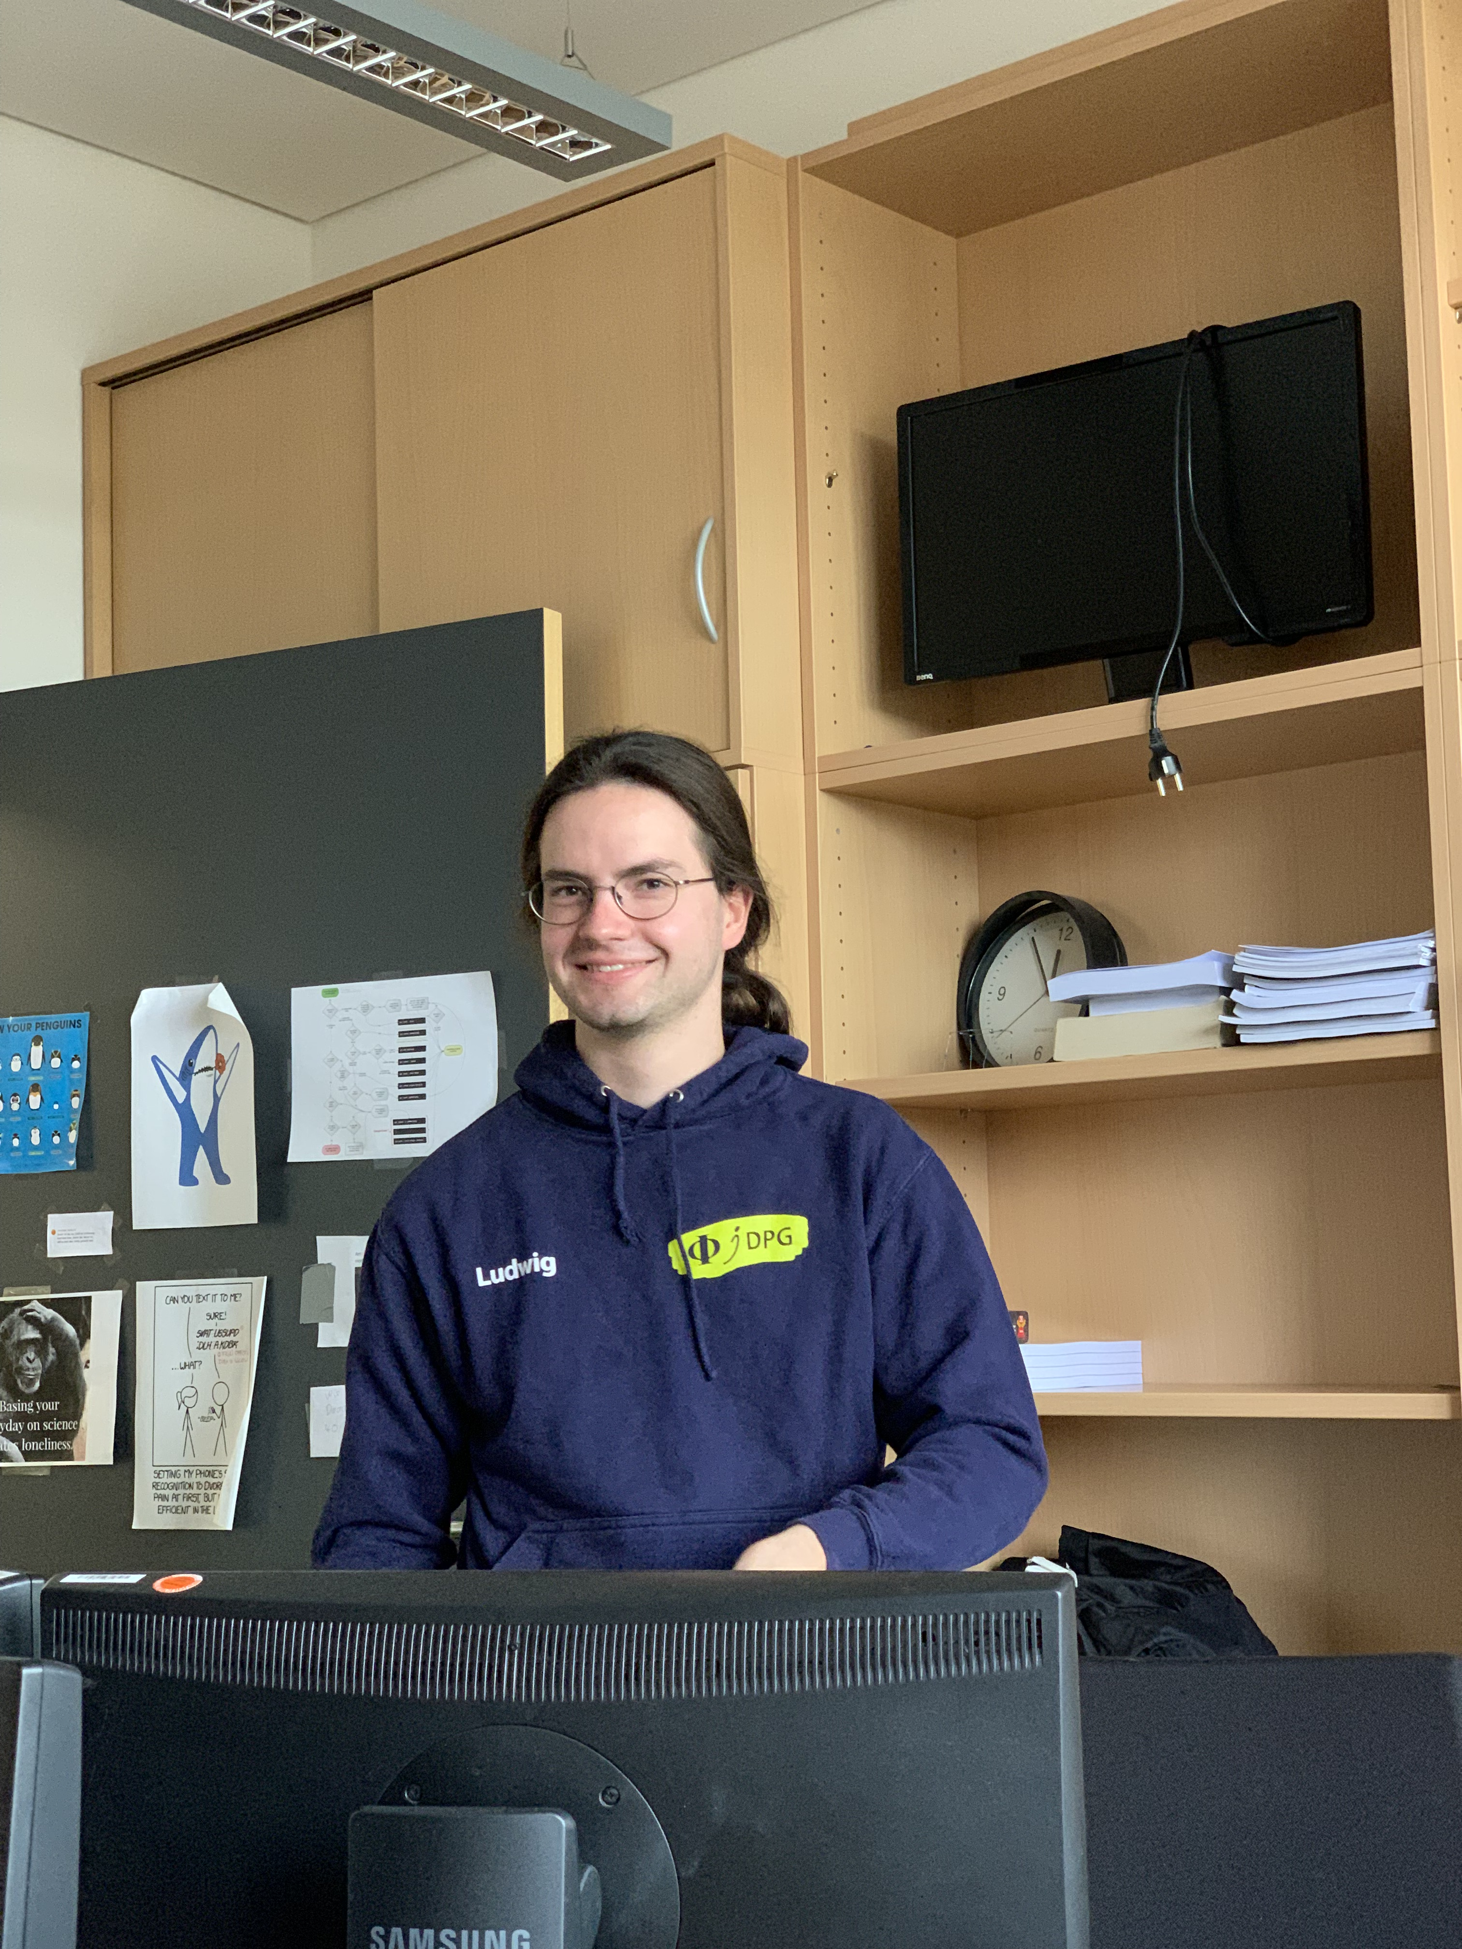
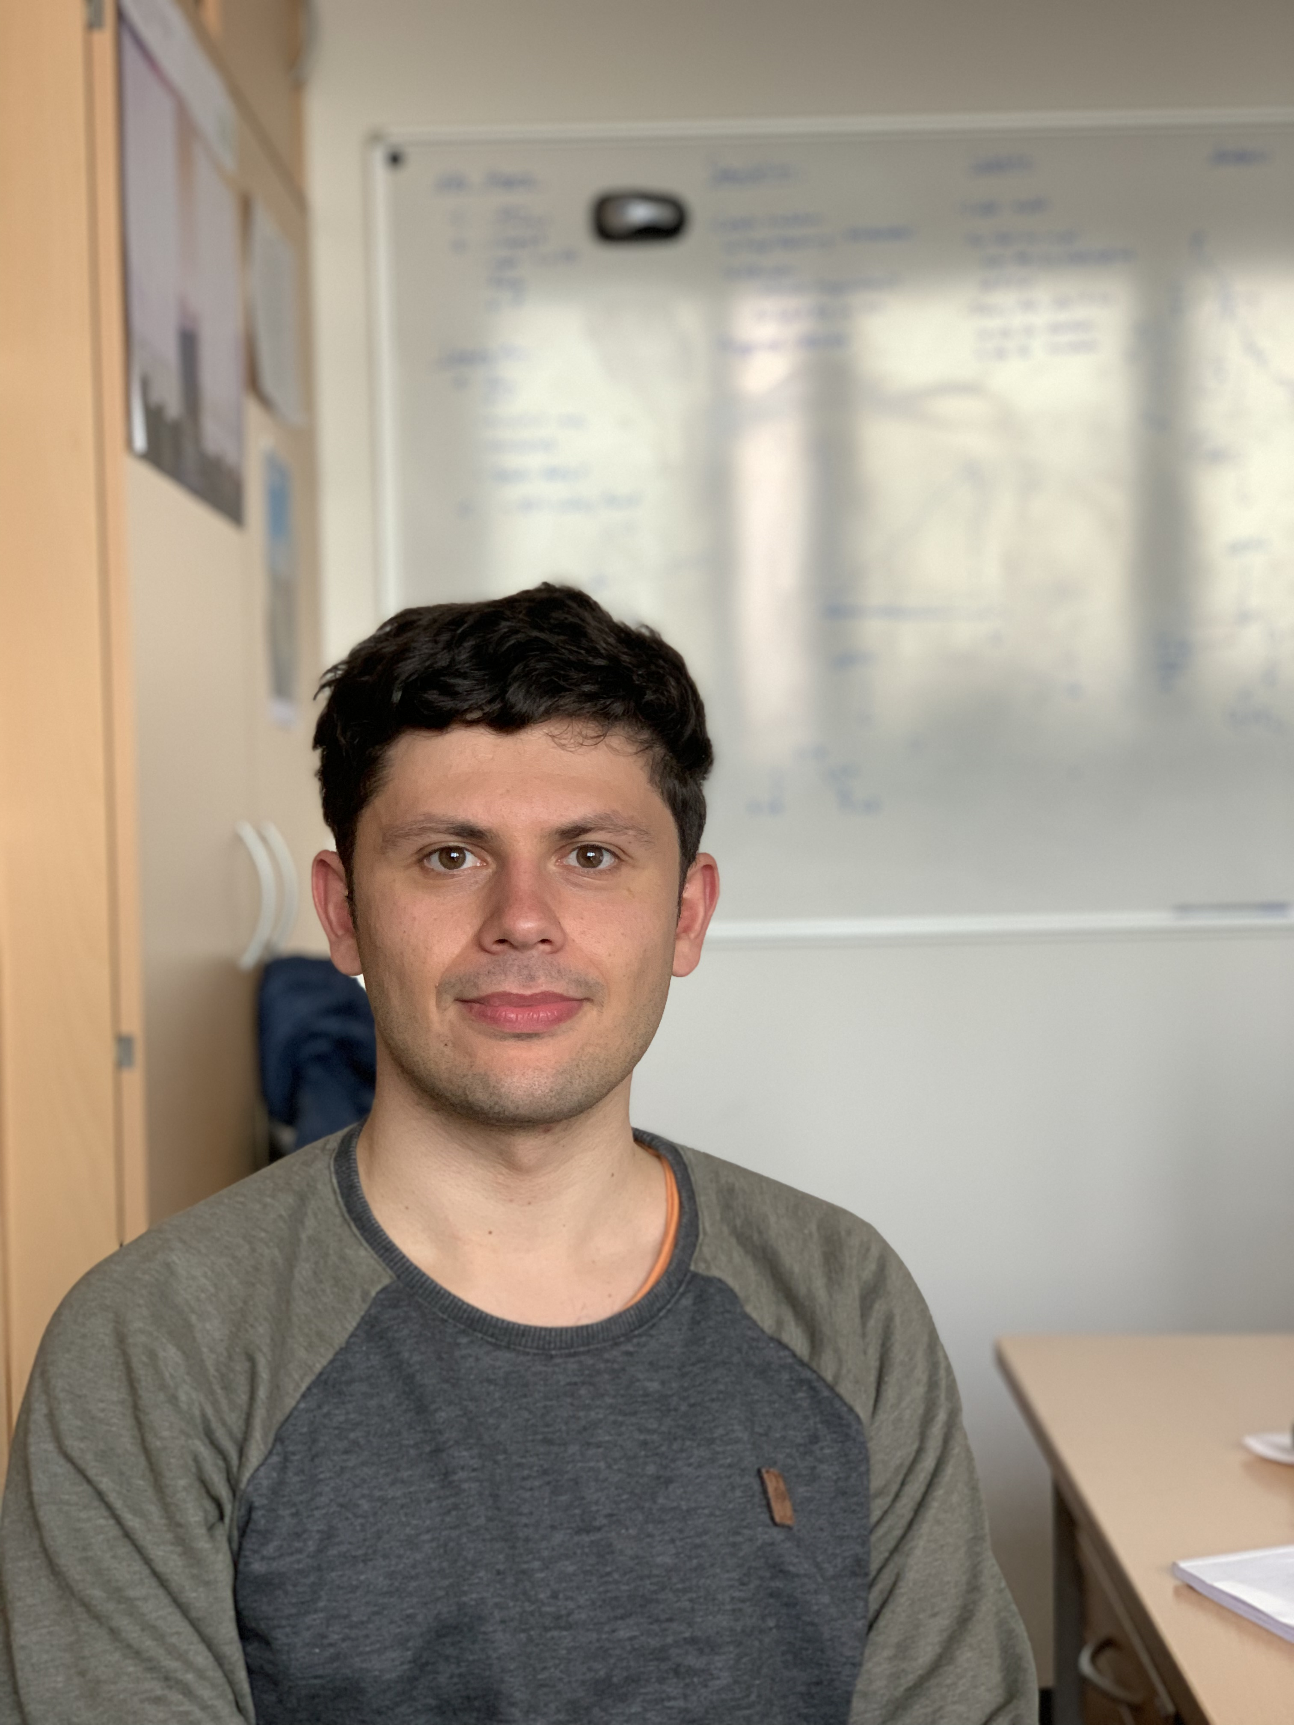

Our team
Ludwig
Neste
ludwig.neste@tu-dortmund.de
Jean-Marco
Alameddine
jean-marco.alameddine@tu-dortmund.de
Thank you for your attention!
We are happy about further inspiration ☺️
Pascal
Gutjahr
pascal.gutjahr@tu-dortmund.de

